Slide 1
R Data Clinic
Ana Bento & Reni Kaul
Aug. 18. 2017

Slide 2
What is R?

Slide 3
R is a language and environment for statistical computing and graphics
Notes:
When I mention CRAN I will say this: is a network of ftp and web servers that store identical, up-to-date, versions of code and documentation and packages for R.

Slide 4
R is a language and environment for statistical computing and graphics
The official R home page: http://www.R-project.org
Notes:
When I mention CRAN I will say this: is a network of ftp and web servers that store identical, up-to-date, versions of code and documentation and packages for R.

Slide 5
R is a language and environment for statistical computing and graphics
The official R home page: http://www.R-project.org
You download it from CRAN: https://cran.r-project.org/
Notes:
When I mention CRAN I will say this: is a network of ftp and web servers that store identical, up-to-date, versions of code and documentation and packages for R.

Slide 6
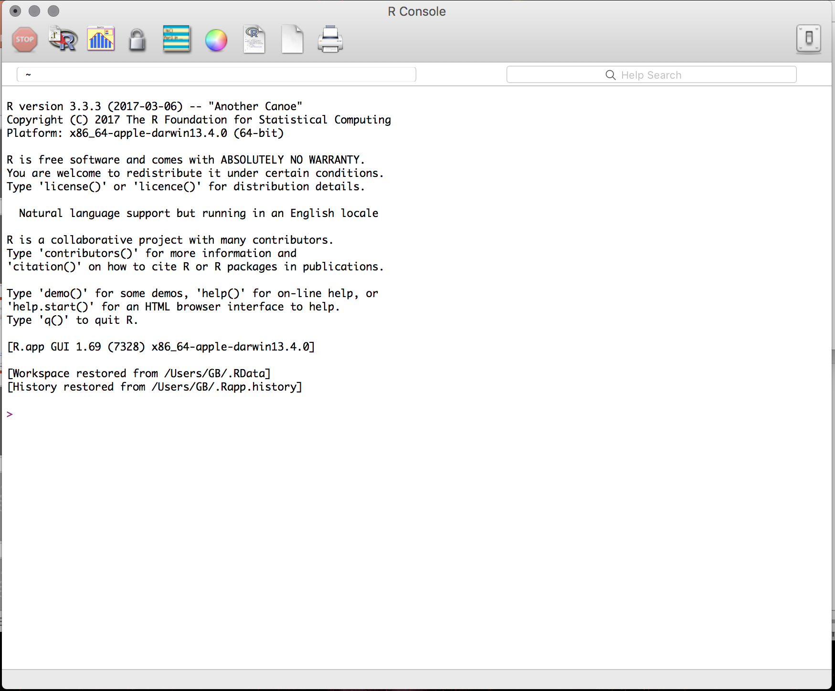
R is a language and environment for statistical computing and graphics
The official R home page: http://www.R-project.org
You download it from CRAN: https://cran.r-project.org/
The R system can be installed on, Windows, Mac or Linux
Notes:
When I mention CRAN I will say this: is a network of ftp and web servers that store identical, up-to-date, versions of code and documentation and packages for R.

Slide 7
Why R?

Slide 8
It’s free
Notes:
It's free!
Popularity -- we can show published papers with plots
Awesome power
can handle complex and large data
can easily program complex simulations
can be used on High Performance Computer Clusters * supports multicore task distribution* Flexibility* Great support * Packages vignettes, tutorials, free books * StackOverflow * R-Bloggers

Slide 9
It’s free
Popularity
Notes:
It's free!
Popularity -- we can show published papers with plots
Awesome power
can handle complex and large data
can easily program complex simulations
can be used on High Performance Computer Clusters * supports multicore task distribution* Flexibility* Great support * Packages vignettes, tutorials, free books * StackOverflow * R-Bloggers

Slide 10
It’s free
Popularity
Awesome power: can handle complex and large data
can easily program complex simulations
can be used on High Performance Computer Clusters
supports multicore task distribution
Notes:
It's free!
Popularity -- we can show published papers with plots
Awesome power
can handle complex and large data
can easily program complex simulations
can be used on High Performance Computer Clusters * supports multicore task distribution* Flexibility* Great support * Packages vignettes, tutorials, free books * StackOverflow * R-Bloggers

Slide 11
It’s free
Popularity
Awesome power: can handle complex and large data
can easily program complex simulations
can be used on High Performance Computer Clusters
supports multicore task distribution
Flexibility
Notes:
It's free!
Popularity -- we can show published papers with plots
Awesome power
can handle complex and large data
can easily program complex simulations
can be used on High Performance Computer Clusters * supports multicore task distribution* Flexibility* Great support * Packages vignettes, tutorials, free books * StackOverflow * R-Bloggers

Slide 12
It’s free
Popularity
Awesome power: can handle complex and large data
can easily program complex simulations
can be used on High Performance Computer Clusters
supports multicore task distribution
Flexibility
Great support: Packages; vignettes; tutorials; free books; google
StackOverflow; Rbloggers my two personal favorites!

Slide 13
R Studio

Slide 14
Using R is easier with RStudio
Notes:
It's free!
Popularity -- we can show published papers with plots
Awesome power
can handle complex and large data
can easily program complex simulations
can be used on High Performance Computer Clusters * supports multicore task distribution* Flexibility* Great support * Packages vignettes, tutorials, free books * StackOverflow * R-Bloggers

Slide 15
Using R is easier with RStudio
Cross platform application
Notes:
It's free!
Popularity -- we can show published papers with plots
Awesome power
can handle complex and large data
can easily program complex simulations
can be used on High Performance Computer Clusters * supports multicore task distribution* Flexibility* Great support * Packages vignettes, tutorials, free books * StackOverflow * R-Bloggers

Slide 16
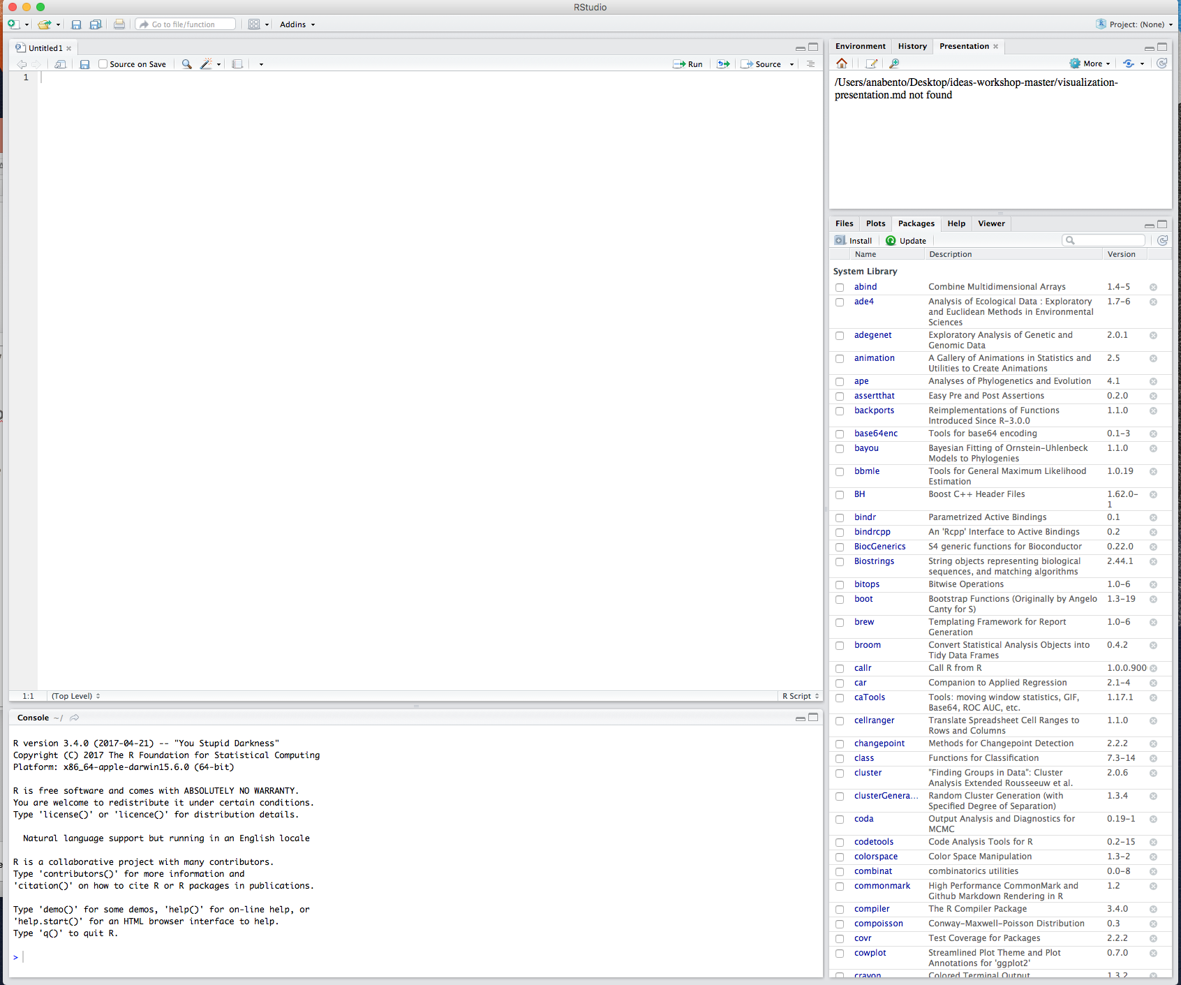
Using R is easier with RStudio
Cross platform application
Download it here: https://www.rstudio.com/products/rstudio/download
Notes:
It's free!
Popularity -- we can show published papers with plots
Awesome power
can handle complex and large data
can easily program complex simulations
can be used on High Performance Computer Clusters * supports multicore task distribution* Flexibility* Great support * Packages vignettes, tutorials, free books * StackOverflow * R-Bloggers

Slide 17
When we first start we have 3 panes: The console (the brain)
The environment & history
Files, plots packages help
The environment and history
Files, plots packages help
The console
Lets open RStudio!
Notes:
Here have them type some basic operations and make a variable assignment!

Slide 18
R packages

Slide 19
R’s functionality is distributed among many packages
Notes:
It's free!
Popularity -- we can show published papers with plots
Awesome power
can handle complex and large data
can easily program complex simulations
can be used on High Performance Computer Clusters * supports multicore task distribution* Flexibility* Great support * Packages vignettes, tutorials, free books * StackOverflow * R-Bloggers

Slide 20
R’s functionality is distributed among many packages
e.g. stats package contains functions for statistical methods
Notes:
It's free!
Popularity -- we can show published papers with plots
Awesome power
can handle complex and large data
can easily program complex simulations
can be used on High Performance Computer Clusters * supports multicore task distribution* Flexibility* Great support * Packages vignettes, tutorials, free books * StackOverflow * R-Bloggers

Slide 21
R’s functionality is distributed among many packages
e.g. stats package contains functions for statistical methods
When you download R you get a set of base packages
Notes:
It's free!
Popularity -- we can show published papers with plots
Awesome power
can handle complex and large data
can easily program complex simulations
can be used on High Performance Computer Clusters * supports multicore task distribution* Flexibility* Great support * Packages vignettes, tutorials, free books * StackOverflow * R-Bloggers

Slide 22
R’s functionality is distributed among many packages
e.g. stats package contains functions for statistical methods
When you download R you get a set of base packages
You can download and install add-on packages in a variety of ways
Notes:
It's free!
Popularity -- we can show published papers with plots
Awesome power
can handle complex and large data
can easily program complex simulations
can be used on High Performance Computer Clusters * supports multicore task distribution* Flexibility* Great support * Packages vignettes, tutorials, free books * StackOverflow * R-Bloggers

Slide 23
R’s functionality is distributed among many packages
e.g. stats package contains functions for statistical methods
When you download R you get a set of base packages
You can download and install add-on packages in a variety of ways
Using the Packages tab in Rstudio (download devtools)
Notes:
It's free!
Popularity -- we can show published papers with plots
Awesome power
can handle complex and large data
can easily program complex simulations
can be used on High Performance Computer Clusters * supports multicore task distribution* Flexibility* Great support * Packages vignettes, tutorials, free books * StackOverflow * R-Bloggers

Slide 24
R’s functionality is distributed among many packages
e.g. stats package contains functions for statistical methods
When you download R you get a set of base packages
You can download and install add-on packages in a variety of ways
Using the Packages tab in Rstudio (download devtools)
Using the command line install.packages(“ggplot2”)
Notes:
It's free!
Popularity -- we can show published papers with plots
Awesome power
can handle complex and large data
can easily program complex simulations
can be used on High Performance Computer Clusters * supports multicore task distribution* Flexibility* Great support * Packages vignettes, tutorials, free books * StackOverflow * R-Bloggers

Slide 25
R’s functionality is distributed among many packages
e.g. stats package contains functions for statistical methods
When you download R you get a set of base packages
You can download and install add-on packages in a variety of ways
Using the Packages tab in Rstudio (download devtools)
Using the command line install.packages(“ggplot2”)
Using devtools install_github(”dgrtwo/gganimate")

Slide 26
R Documentation

Slide 27
https://cran.r-project.org/web/packages/ggplot2/index.html
Notes:
It's free!
Popularity -- we can show published papers with plots
Awesome power
can handle complex and large data
can easily program complex simulations
can be used on High Performance Computer Clusters * supports multicore task distribution* Flexibility* Great support * Packages vignettes, tutorials, free books * StackOverflow * R-Bloggers

Slide 28
https://cran.r-project.org/web/packages/ggplot2/index.html
Reference manual pdf
Notes:
It's free!
Popularity -- we can show published papers with plots
Awesome power
can handle complex and large data
can easily program complex simulations
can be used on High Performance Computer Clusters * supports multicore task distribution* Flexibility* Great support * Packages vignettes, tutorials, free books * StackOverflow * R-Bloggers

Slide 29
https://cran.r-project.org/web/packages/ggplot2/index.html
Reference manual pdf
Vignettes
Notes:
It's free!
Popularity -- we can show published papers with plots
Awesome power
can handle complex and large data
can easily program complex simulations
can be used on High Performance Computer Clusters * supports multicore task distribution* Flexibility* Great support * Packages vignettes, tutorials, free books * StackOverflow * R-Bloggers

Slide 30
https://cran.r-project.org/web/packages/ggplot2/index.html
Reference manual pdf
Vignettes
https://www.rdocumentation.org/packages/ggplot2/versions/2.2.1
Notes:
It's free!
Popularity -- we can show published papers with plots
Awesome power
can handle complex and large data
can easily program complex simulations
can be used on High Performance Computer Clusters * supports multicore task distribution* Flexibility* Great support * Packages vignettes, tutorials, free books * StackOverflow * R-Bloggers

Slide 31
https://cran.r-project.org/web/packages/ggplot2/index.html
Reference manual pdf
Vignettes
https://www.rdocumentation.org/packages/ggplot2/versions/2.2.1
Using the console to search for info on a specific function
e.g. ?read.csv or ??read.csv
Notes:
It's free!
Popularity -- we can show published papers with plots
Awesome power
can handle complex and large data
can easily program complex simulations
can be used on High Performance Computer Clusters * supports multicore task distribution* Flexibility* Great support * Packages vignettes, tutorials, free books * StackOverflow * R-Bloggers

Slide 32
Troubleshooting

Slide 34
Reproducibility

Slide 35
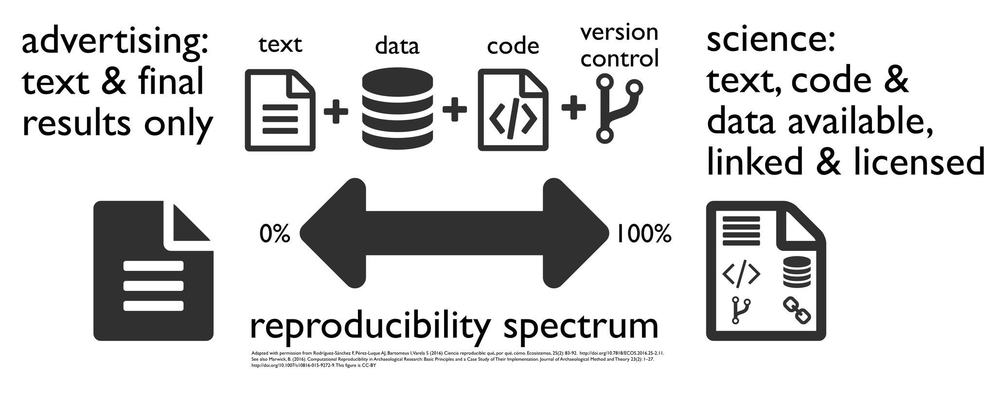
Notes:
It's free!
Popularity -- we can show published papers with plots
Awesome power
can handle complex and large data
can easily program complex simulations
can be used on High Performance Computer Clusters * supports multicore task distribution* Flexibility* Great support * Packages vignettes, tutorials, free books * StackOverflow * R-Bloggers

Slide 36
Goals

Slide 37
Simulating ODEs
Notes:
It's free!
Popularity -- we can show published papers with plots
Awesome power
can handle complex and large data
can easily program complex simulations
can be used on High Performance Computer Clusters * supports multicore task distribution* Flexibility* Great support * Packages vignettes, tutorials, free books * StackOverflow * R-Bloggers

Slide 38
Simulating ODEs
Writing functions
Notes:
It's free!
Popularity -- we can show published papers with plots
Awesome power
can handle complex and large data
can easily program complex simulations
can be used on High Performance Computer Clusters * supports multicore task distribution* Flexibility* Great support * Packages vignettes, tutorials, free books * StackOverflow * R-Bloggers

Slide 39
Simulating ODEs
Writing functions
Calculating summary statistics
Notes:
It's free!
Popularity -- we can show published papers with plots
Awesome power
can handle complex and large data
can easily program complex simulations
can be used on High Performance Computer Clusters * supports multicore task distribution* Flexibility* Great support * Packages vignettes, tutorials, free books * StackOverflow * R-Bloggers

Slide 40
Simulating ODEs
Writing functions
Calculating summary statistics
Plotting results
Notes:
It's free!
Popularity -- we can show published papers with plots
Awesome power
can handle complex and large data
can easily program complex simulations
can be used on High Performance Computer Clusters * supports multicore task distribution* Flexibility* Great support * Packages vignettes, tutorials, free books * StackOverflow * R-Bloggers

Slide 41
Today

Slide 42
Data Types
Vectors
Matrices
Factors
Data frames
Lists
Notes:
It's free!
Popularity -- we can show published papers with plots
Awesome power
can handle complex and large data
can easily program complex simulations
can be used on High Performance Computer Clusters * supports multicore task distribution* Flexibility* Great support * Packages vignettes, tutorials, free books * StackOverflow * R-Bloggers

Slide 43
Data Types
Vectors
Matrices
Factors
Data frames
Lists
Writing a script
Notes:
It's free!
Popularity -- we can show published papers with plots
Awesome power
can handle complex and large data
can easily program complex simulations
can be used on High Performance Computer Clusters * supports multicore task distribution* Flexibility* Great support * Packages vignettes, tutorials, free books * StackOverflow * R-Bloggers

Slide 44
Data Types
Vectors
Matrices
Factors
Data frames
Lists
Writing a script
Data Manipulation - Exercise
Notes:
It's free!
Popularity -- we can show published papers with plots
Awesome power
can handle complex and large data
can easily program complex simulations
can be used on High Performance Computer Clusters * supports multicore task distribution* Flexibility* Great support * Packages vignettes, tutorials, free books * StackOverflow * R-Bloggers

Slide 45
Data Types
Vectors
Matrices
Factors
Data frames
Lists
Writing a script
Data Manipulation - Exercise
Functions
examples of functions - Exercises
loops - Exercises
summary stats
Notes:
It's free!
Popularity -- we can show published papers with plots
Awesome power
can handle complex and large data
can easily program complex simulations
can be used on High Performance Computer Clusters * supports multicore task distribution* Flexibility* Great support * Packages vignettes, tutorials, free books * StackOverflow * R-Bloggers

Slide 46
Tomorrow

Slide 47
Recap script & scramble exercises
Data visualization
basic
ggplot
plottly (interactive plots)
Collaborative coding
Simulations
Notes:
It's free!
Popularity -- we can show published papers with plots
Awesome power
can handle complex and large data
can easily program complex simulations
can be used on High Performance Computer Clusters * supports multicore task distribution* Flexibility* Great support * Packages vignettes, tutorials, free books * StackOverflow * R-Bloggers

Slide 48
Code to produce this plot
require(gganimate)
require(tweenr))
## adding text
tweenlogo <- data.frame(x=0.25, y=0.5, label = 'Lets staRt', stringsAsFactors = F)
tweenlogo <- tweenlogo[rep(1, 60),]
tweenlogo$.frame <- 316:375
##creating the data for the dropping balls
d <- data.frame(x = rnorm(20), y = rnorm(20), time = sample(100, 20), alpha = 0,
size = 1, ease = 'elastic-out', id = 1:20,
stringsAsFactors = FALSE)
d2 <- d
d2$time <- d$time + 10
d2$alpha <- 1
d2$size <- 3
d2$ease <- 'linear'
d3 <- d2
d3$time <- d2$time + sample(50:100, 20)
d3$size = 10
d3$ease <- 'bounce-out'
d4 <- d3
d4$y <- min(d$y) - 0.5
d4$size <- 2
d4$time <- d3$time + 10
d5 <- d4
d5$time <- max(d5$time)
df <- rbind(d, d2, d3, d4, d5)
# Using tweenr
dt <- tween_elements(df, 'time', 'id', 'ease', nframes = 500)
# Animate with gganimate
p <- ggplot(data = dt,aes(x=x, y=y)) + geom_text(aes(label = label, frame = .frame), data=tweenlogo, size = 13)+theme_bw()+
geom_point(aes(x=x, y=y, size=size, alpha=alpha, frame = .frame)) +
scale_size(range = c(0.1, 20), guide = 'none') +
scale_alpha(range = c(0, 1), guide = 'none') +
ggforce::theme_no_axes()
animation::ani.options(interval = 1/150)
gganimate(p, 'dropping balls.gif', title_frame = F)

